Slide 1



Shop for home
popular store in the market for shopping the home décor stuff
Project Members:
Shrutika Patil
Abhishek Patel
Chaitanya Varma
Sumit Kumar
Anshuman Gupta
Mentor:
Jayashruthi Loganathan

Slide 2

OVERVIEW
Problem Statement
Objective
Features
Project Structure
Project Flow
Tools and Technologies
User Interface (Snapshots)
Conclusion

Slide 3



Problem Statement
Shop For Home is a popular Store in the market for shopping the home décor stuff .Due to Covid 19 all the offline shopping stopped. So, the store wants to move to the online platforms and wants their own web application.

Slide 4
OBJECTIVE
To build an application which allows users to shop online.
User should be able to Register and Login.
Logged in user should be able to add different products to cart to checkout at once.
User should be able view his past purchases.
Admins can add or remove product, categories and banners.
The interface of the application should be easy enough to be understood by anyone.

Slide 5

FEATURES
Authentication
Users are able to register and login using email and password
Products
Users can view products based on category or search.
Admins can add and remove products.
Cart
User can add items to cart as per their requirement
Users can remove items from cart and update the quantity
Coupon Discount
User can filter products based on price
Admin are able to register and login using email and password
Also admin can add the bulk of product in product page
. As a user I should get different discount coupons.
As an Admin I should be able to set the discount coupons for the specific set of users

Slide 6


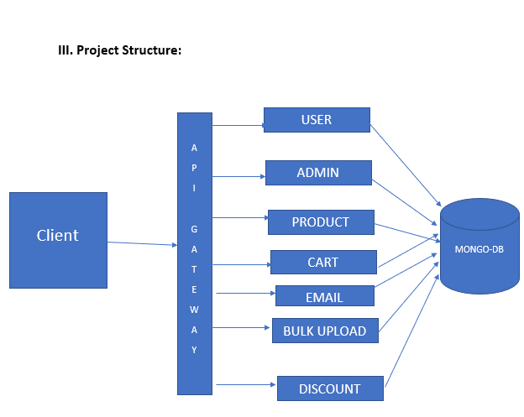
Project STRUCTURE

Slide 7

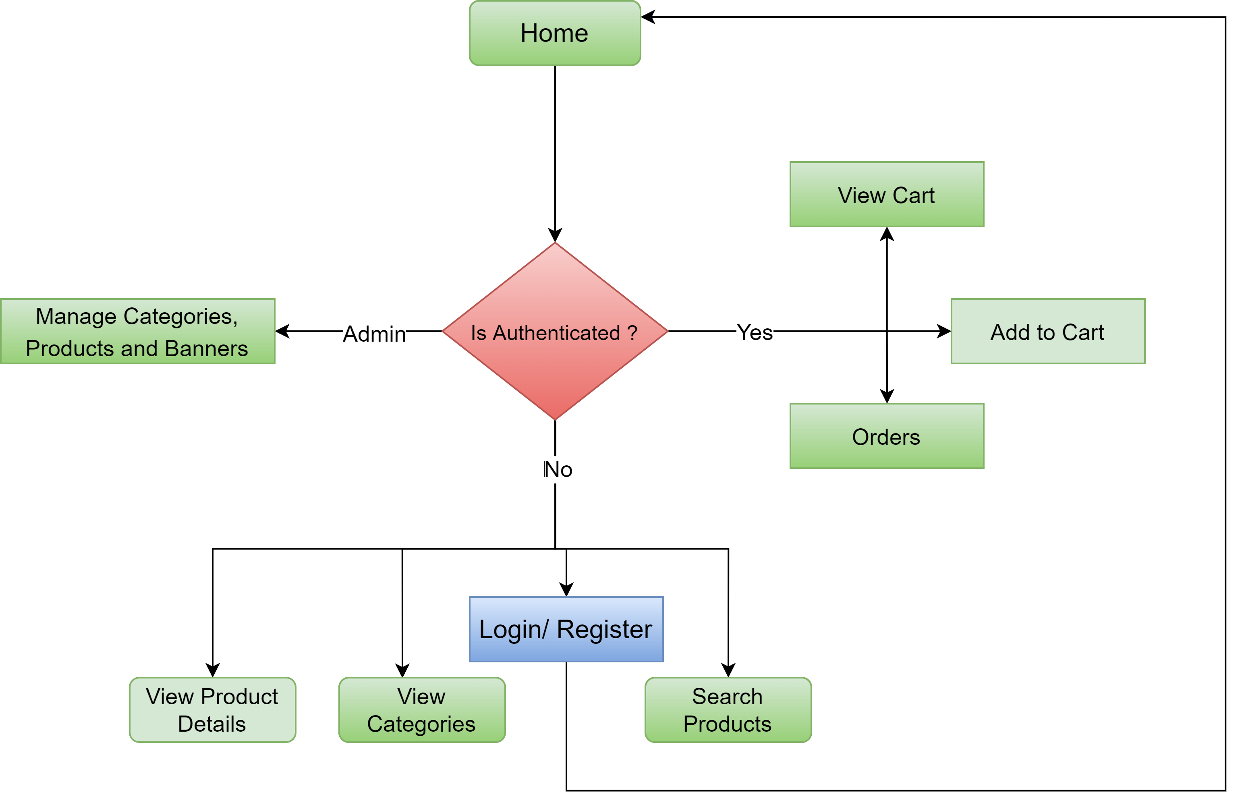
Project FLOW

Slide 8





Tools AND TECHNOLOGIES
Frontend : ReactJS
Backend : ExpressJS
VCS : GitHub
Database : MongoDB

Slide 9
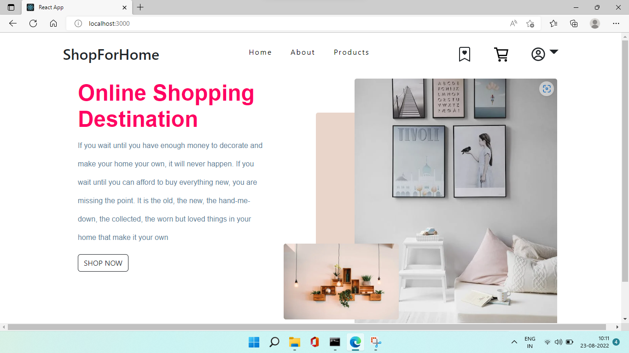
USER INTERFACE (LANDING)

Slide 10
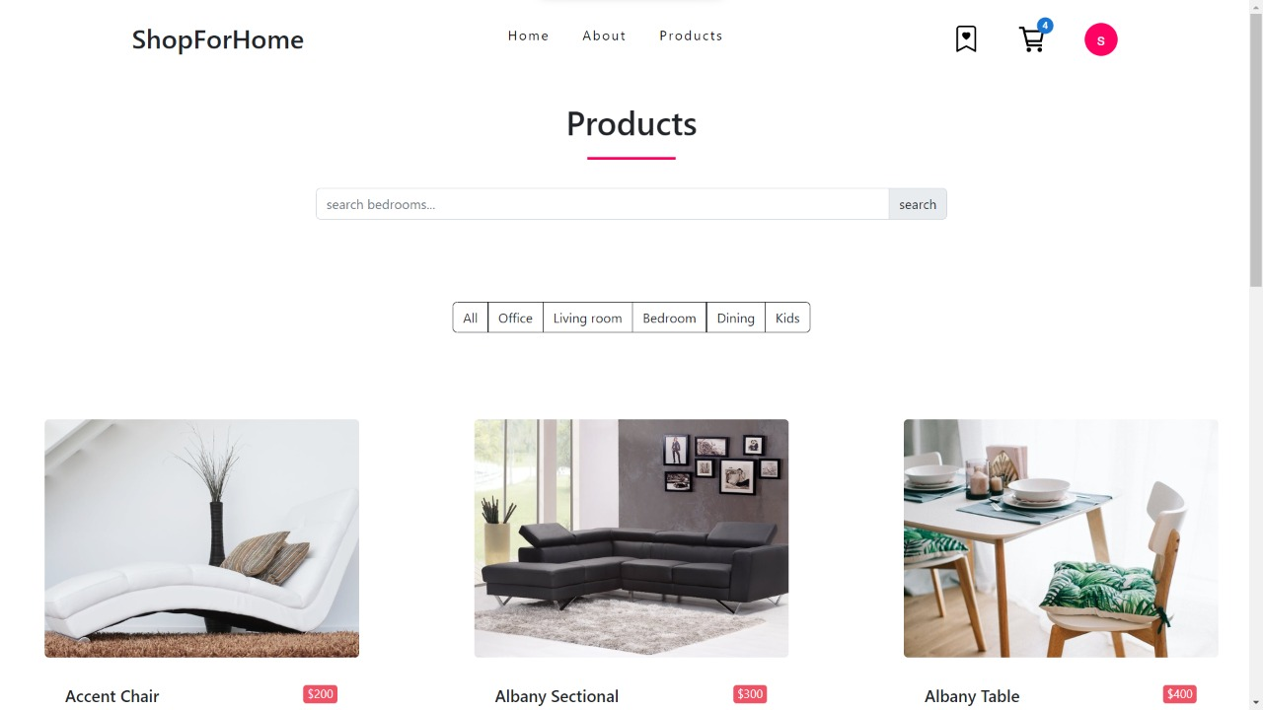
USER INTERFACE (PRODUCT)

Slide 11
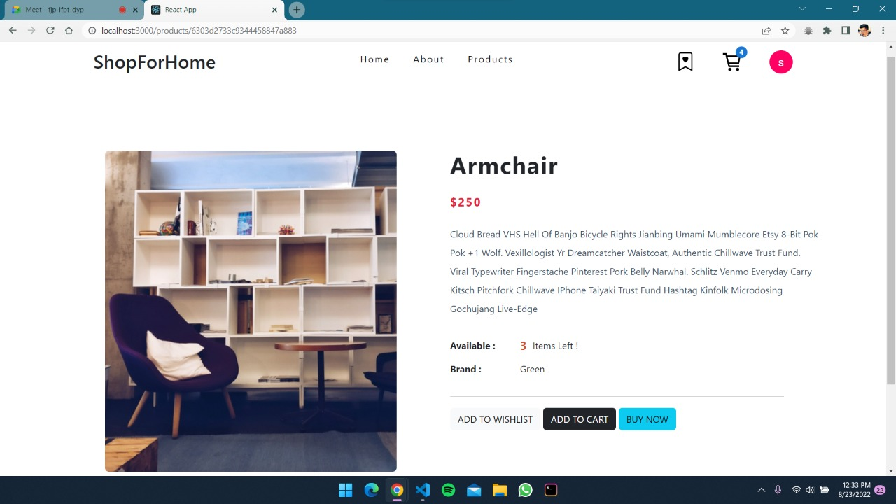
USER INTERFACE (Product dEscription)

Slide 12
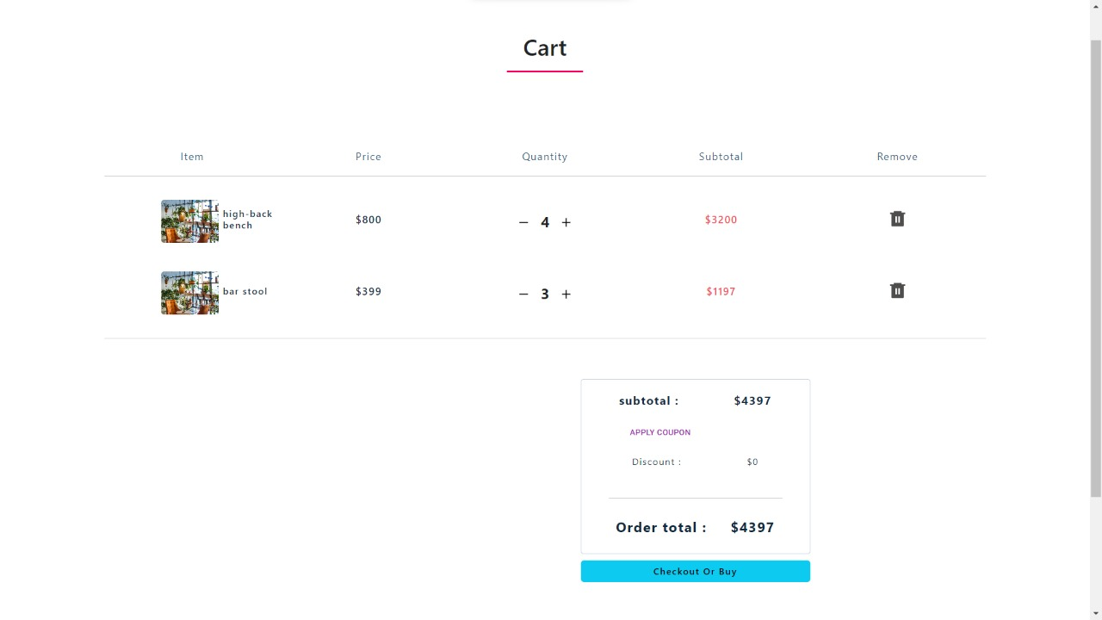
USER INTERFACE (CART)

Slide 13
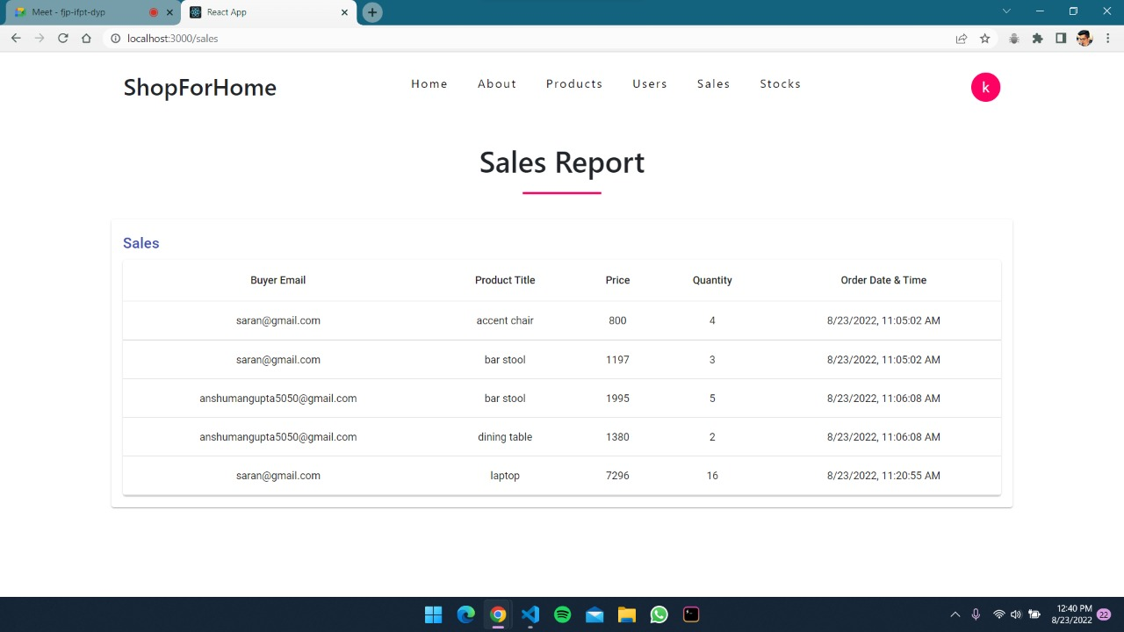
Sales Report

Slide 14
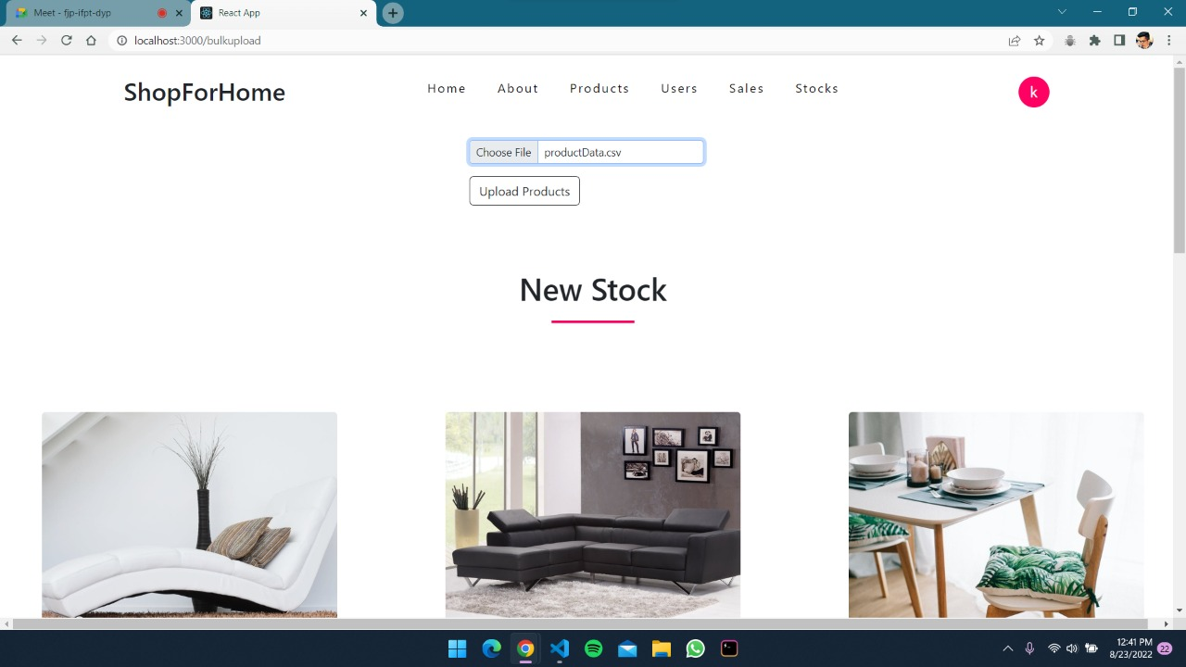
Bulk upload

Slide 15
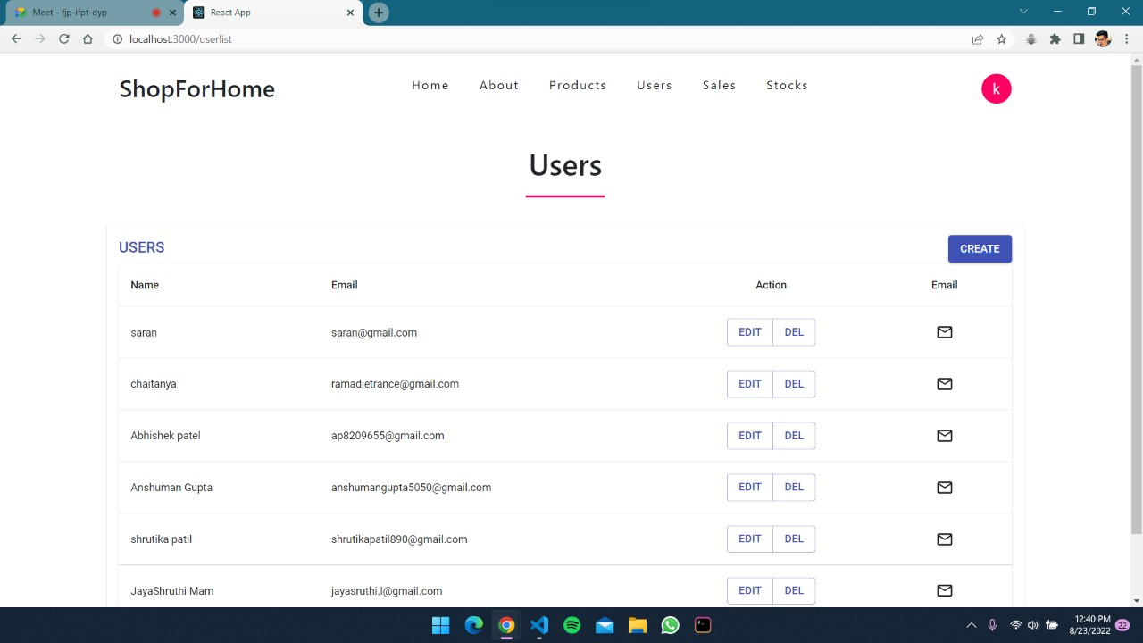
Users list

Slide 16
Advantages
The product name and description are used to create indexes which helps in improving the search.
All the API requests are cached to limit duplicate API calls.
User can access products by searching or by categories and can also apply price filters to find his desired item.

Slide 17
Future ENHANCEMENTS
Different categories require different filters, category based filters can be implemented.
Products reviews can be added to allow user to clear his doubt about the product.
Real payment gateway can be added to complete the application.

Slide 18
Conclusion
The internet has led to birth and evolution of E-commerce. Ecommerce has now become a key component of many organisations in the daily running of their business.
The application has an easy to understand interface which can be used by any user.
The application allows the user to shop online and helps him in looking for his item of interest.
If the logged in user is identified as admin, he can easily update the inventory from the settings.

Slide 19

Thank You!

